Slide 1
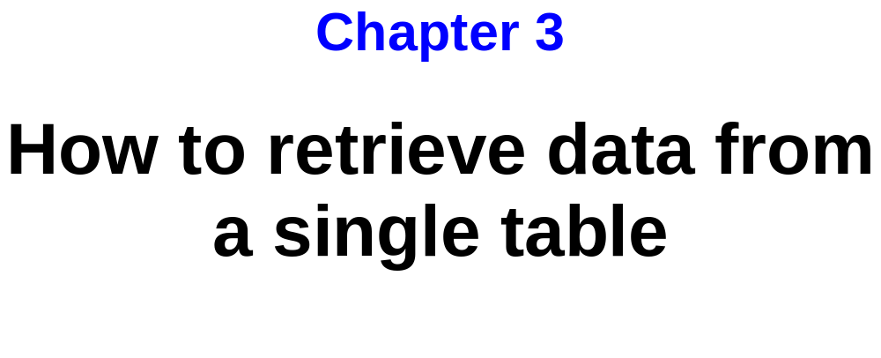
Murach’s Oracle SQL and PL/SQL, C3
© 2014, Mike Murach & Associates, Inc.
Slide <number>

Slide 2
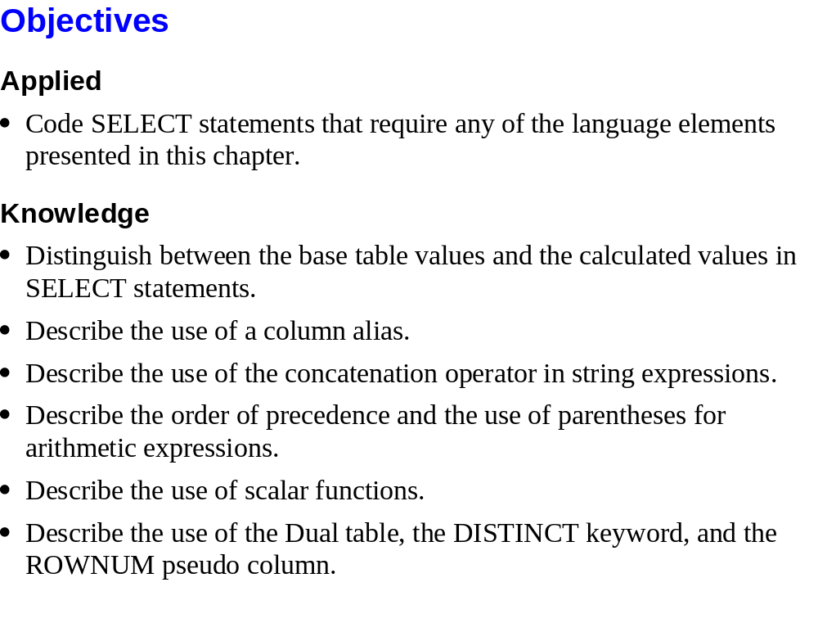
Murach’s Oracle SQL and PL/SQL, C3
© 2014, Mike Murach & Associates, Inc.
Slide <number>

Slide 3
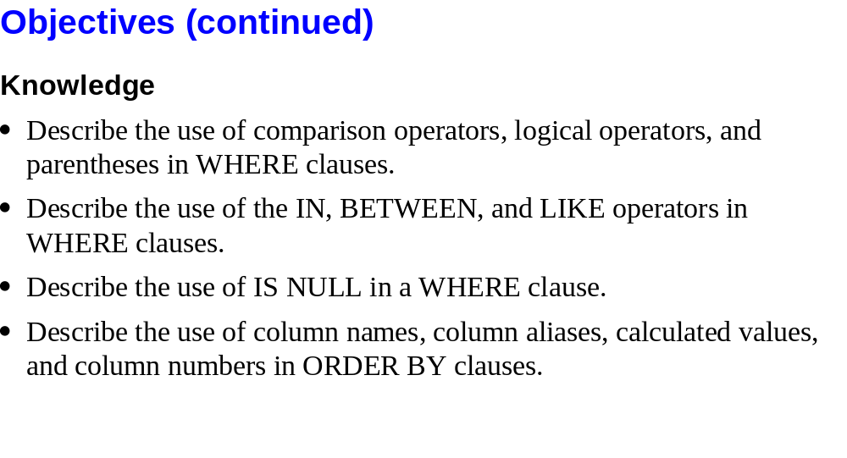
Murach’s Oracle SQL and PL/SQL, C3
© 2014, Mike Murach & Associates, Inc.
Slide <number>

Slide 4
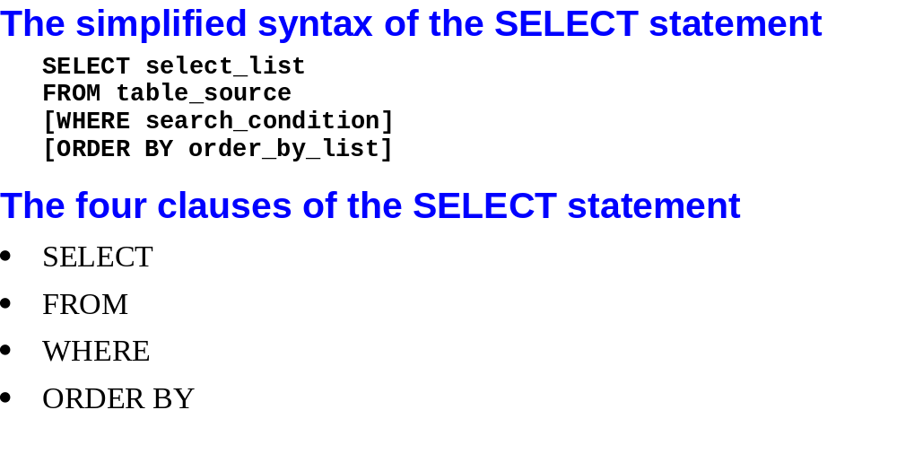
Murach’s Oracle SQL and PL/SQL, C3
© 2014, Mike Murach & Associates, Inc.
Slide <number>

Slide 5
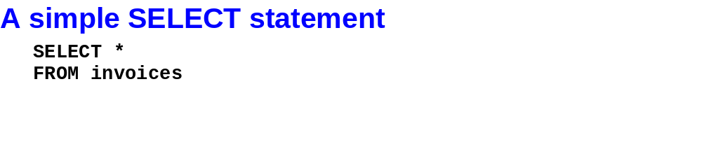
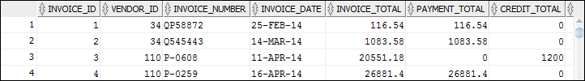
Murach’s Oracle SQL and PL/SQL, C3
© 2014, Mike Murach & Associates, Inc.
Slide <number>

Slide 6
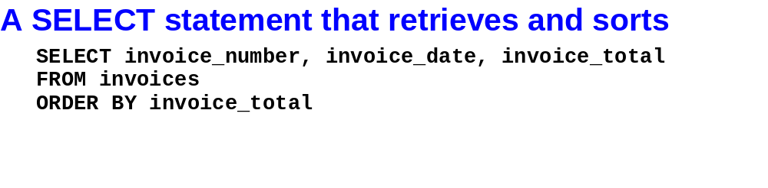
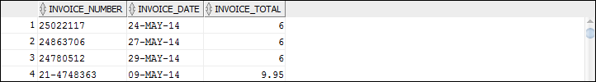
Murach’s Oracle SQL and PL/SQL, C3
© 2014, Mike Murach & Associates, Inc.
Slide <number>

Slide 7
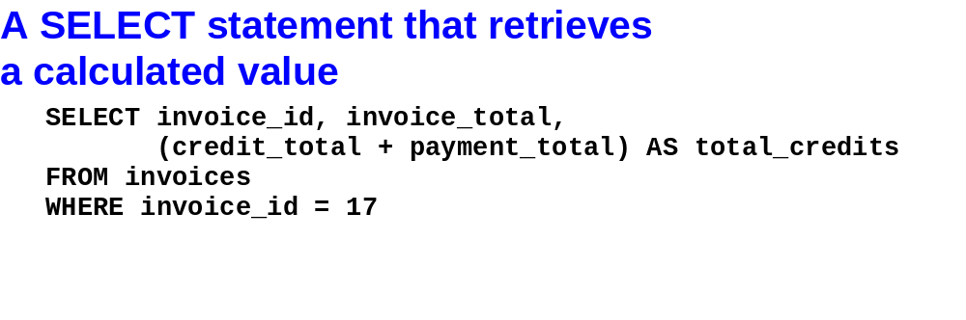
Murach’s Oracle SQL and PL/SQL, C3
© 2014, Mike Murach & Associates, Inc.
Slide <number>

Slide 8
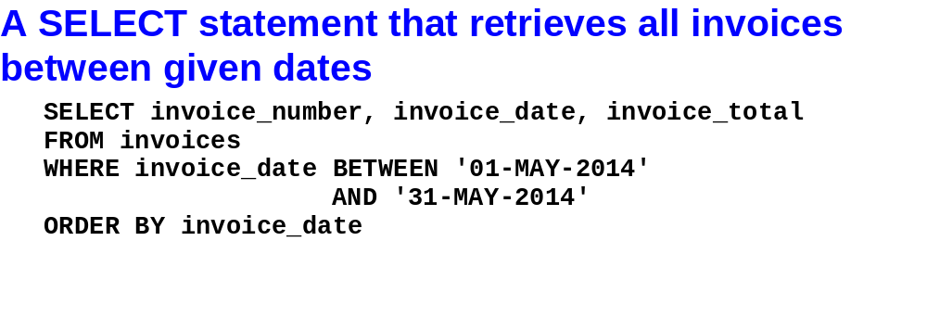
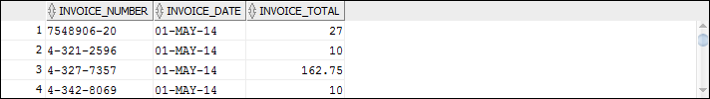
Murach’s Oracle SQL and PL/SQL, C3
© 2014, Mike Murach & Associates, Inc.
Slide <number>

Slide 9
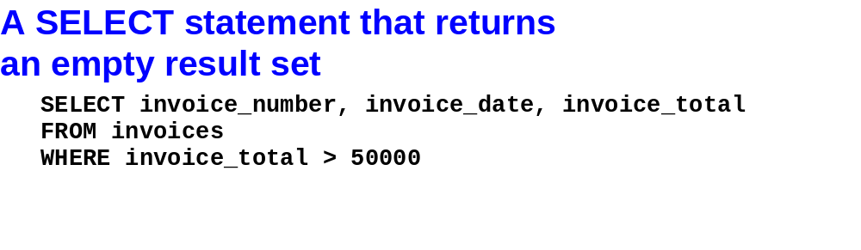
Murach’s Oracle SQL and PL/SQL, C3
© 2014, Mike Murach & Associates, Inc.
Slide <number>

Slide 10
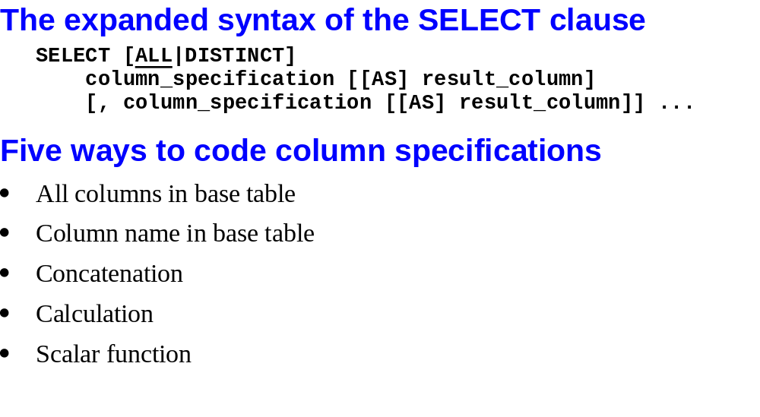
Murach’s Oracle SQL and PL/SQL, C3
© 2014, Mike Murach & Associates, Inc.
Slide <number>

Slide 11
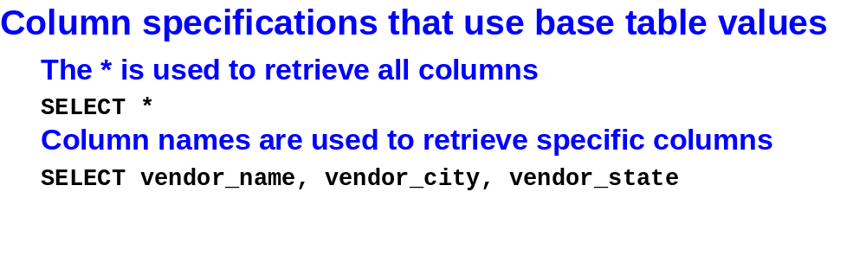
Murach’s Oracle SQL and PL/SQL, C3
© 2014, Mike Murach & Associates, Inc.
Slide <number>

Slide 12
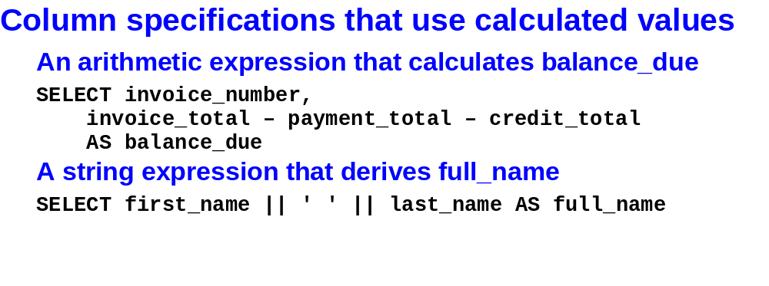
Murach’s Oracle SQL and PL/SQL, C3
© 2014, Mike Murach & Associates, Inc.
Slide <number>

Slide 13
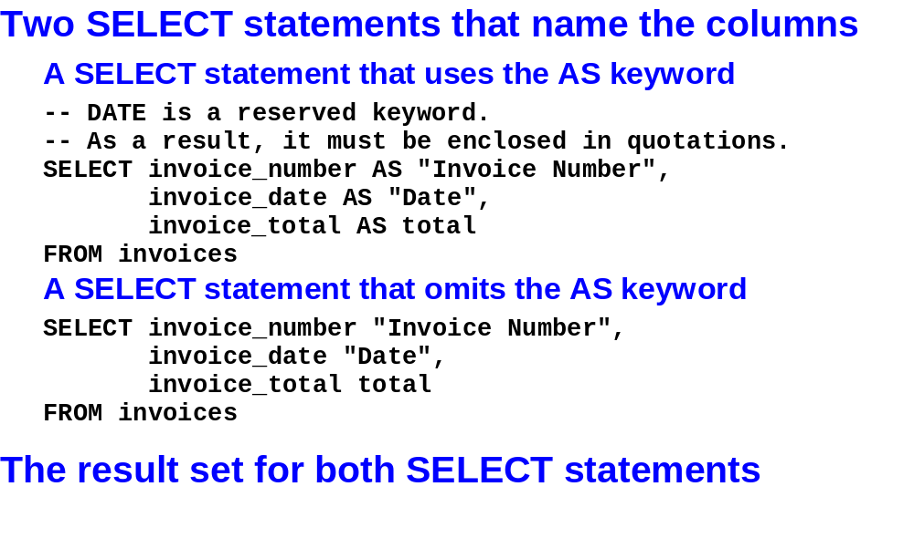
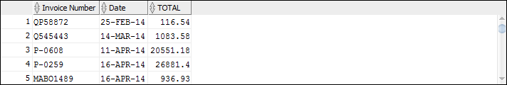
Murach’s Oracle SQL and PL/SQL, C3
© 2014, Mike Murach & Associates, Inc.
Slide <number>

Slide 14
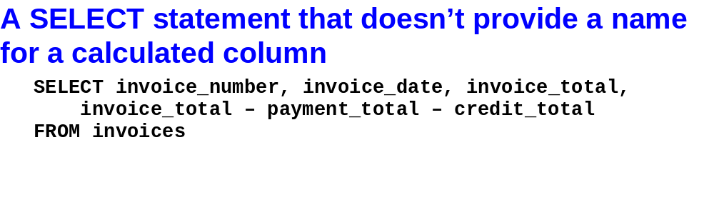
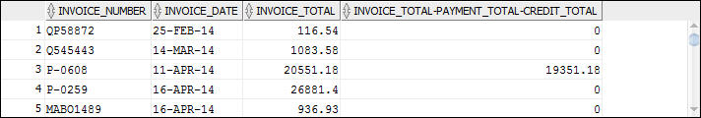
Murach’s Oracle SQL and PL/SQL, C3
© 2014, Mike Murach & Associates, Inc.
Slide <number>

Slide 15

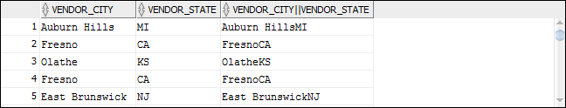
Murach’s Oracle SQL and PL/SQL, C3
© 2014, Mike Murach & Associates, Inc.
Slide <number>

Slide 16
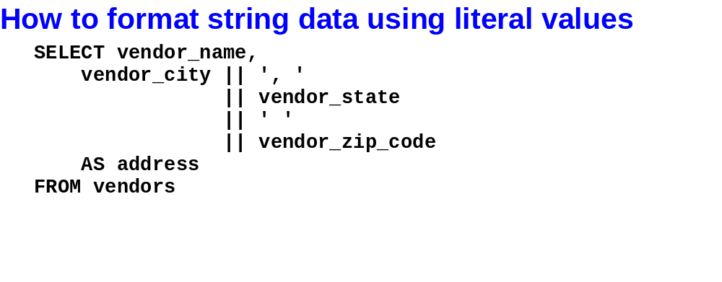
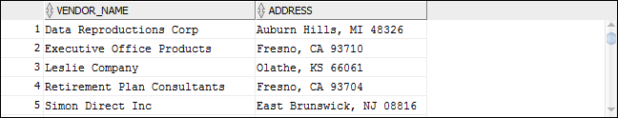
Murach’s Oracle SQL and PL/SQL, C3
© 2014, Mike Murach & Associates, Inc.
Slide <number>

Slide 17
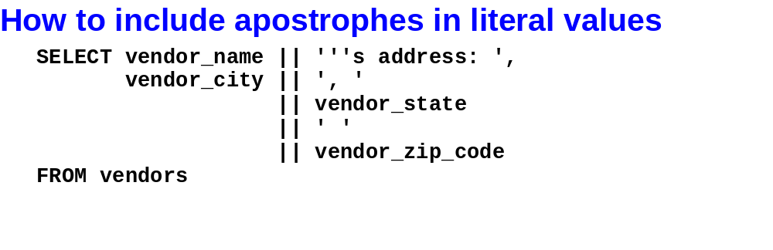
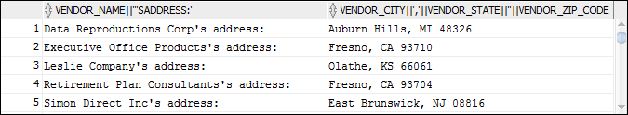
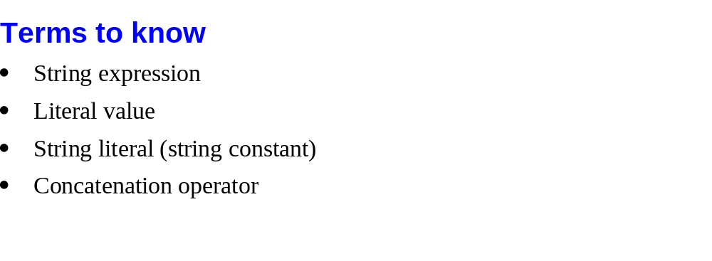
Murach’s Oracle SQL and PL/SQL, C3
© 2014, Mike Murach & Associates, Inc.
Slide <number>

Slide 18
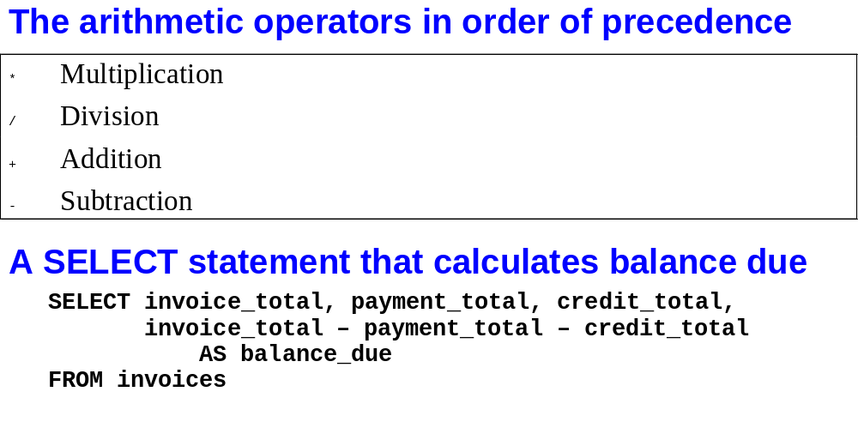
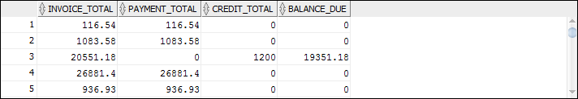
Murach’s Oracle SQL and PL/SQL, C3
© 2014, Mike Murach & Associates, Inc.
Slide <number>

Slide 19
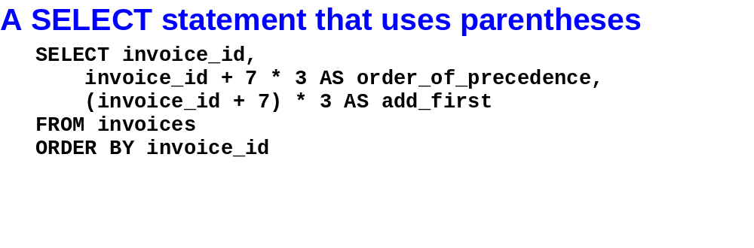
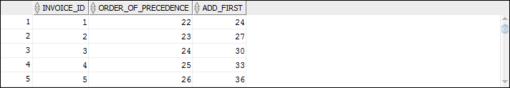
Murach’s Oracle SQL and PL/SQL, C3
© 2014, Mike Murach & Associates, Inc.
Slide <number>

Slide 20
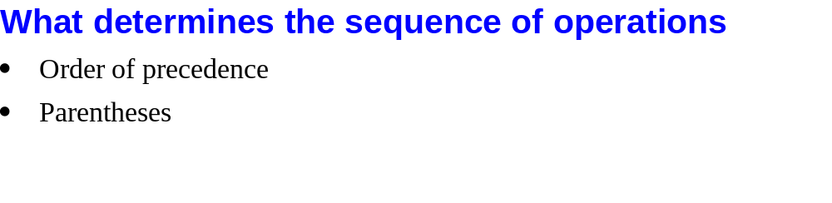
Murach’s Oracle SQL and PL/SQL, C3
© 2014, Mike Murach & Associates, Inc.
Slide <number>

Slide 21
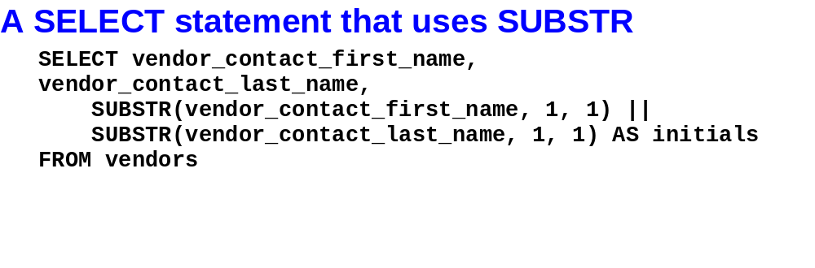
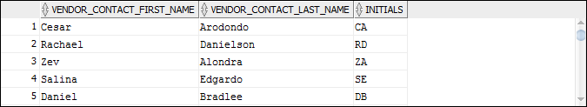
Murach’s Oracle SQL and PL/SQL, C3
© 2014, Mike Murach & Associates, Inc.
Slide <number>

Slide 22
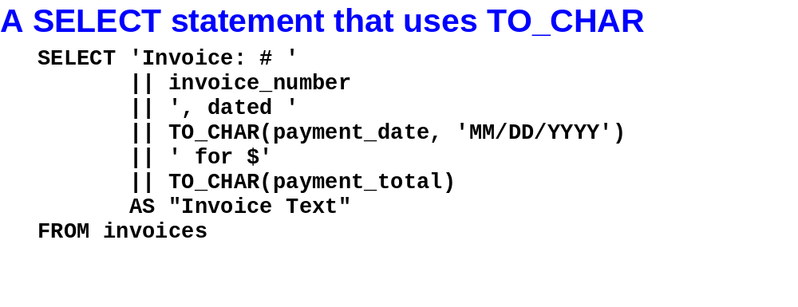
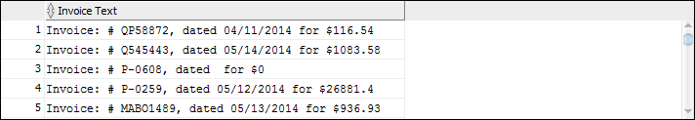
Murach’s Oracle SQL and PL/SQL, C3
© 2014, Mike Murach & Associates, Inc.
Slide <number>

Slide 23
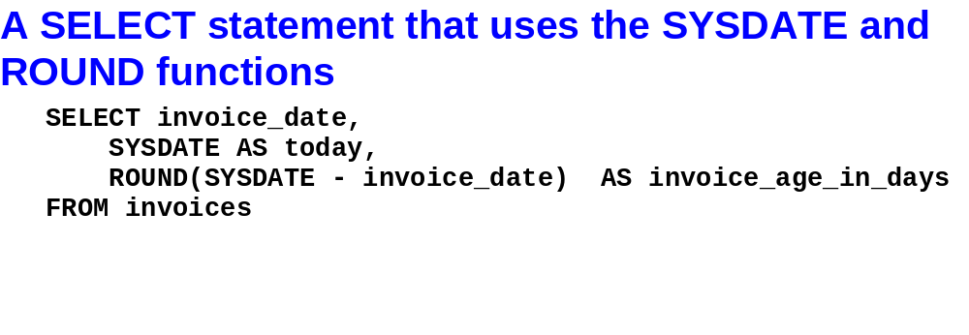

Murach’s Oracle SQL and PL/SQL, C3
© 2014, Mike Murach & Associates, Inc.
Slide <number>

Slide 24
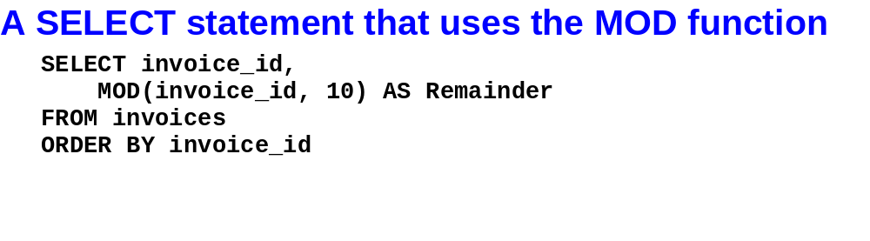

Murach’s Oracle SQL and PL/SQL, C3
© 2014, Mike Murach & Associates, Inc.
Slide <number>

Slide 25
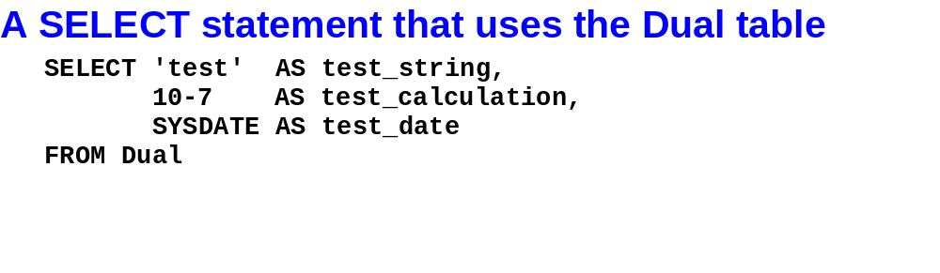
Murach’s Oracle SQL and PL/SQL, C3
© 2014, Mike Murach & Associates, Inc.
Slide <number>

Slide 26

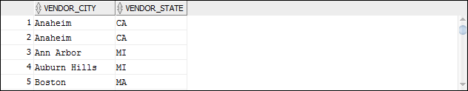
Murach’s Oracle SQL and PL/SQL, C3
© 2014, Mike Murach & Associates, Inc.
Slide <number>

Slide 27
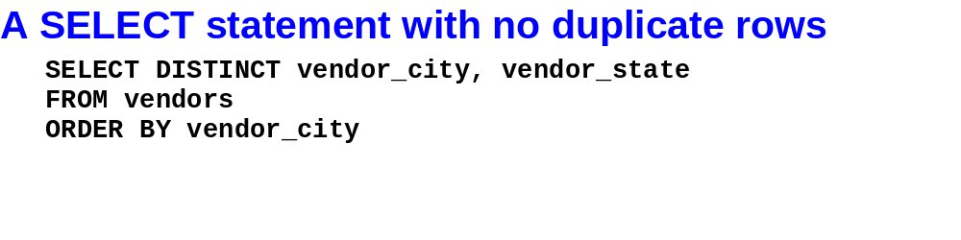
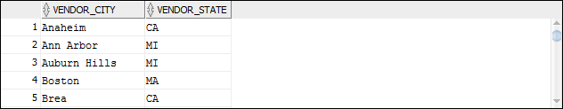
Murach’s Oracle SQL and PL/SQL, C3
© 2014, Mike Murach & Associates, Inc.
Slide <number>

Slide 28
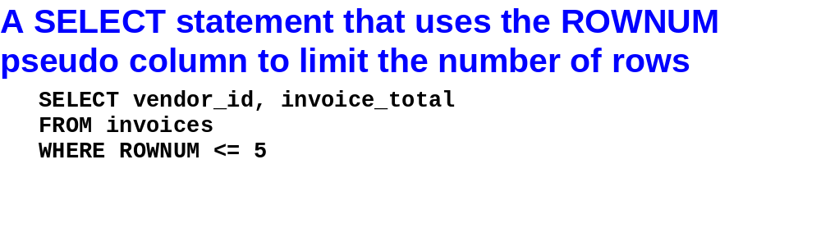
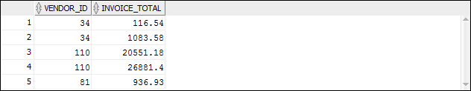
Murach’s Oracle SQL and PL/SQL, C3
© 2014, Mike Murach & Associates, Inc.
Slide <number>

Slide 29
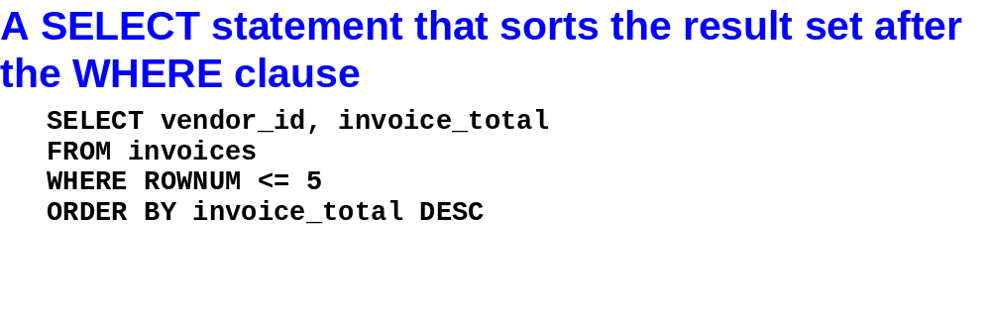
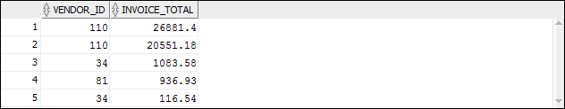
Murach’s Oracle SQL and PL/SQL, C3
© 2014, Mike Murach & Associates, Inc.
Slide <number>

Slide 30
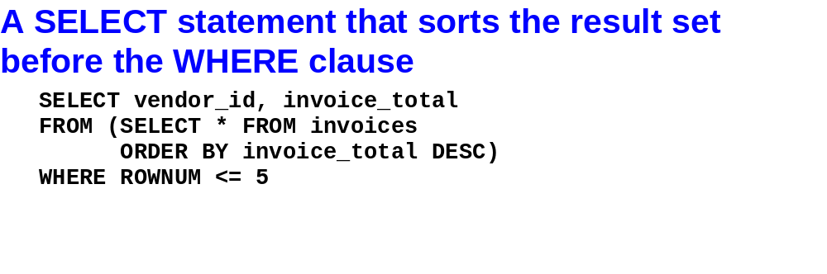
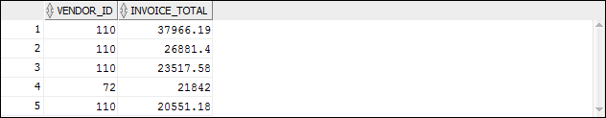
Murach’s Oracle SQL and PL/SQL, C3
© 2014, Mike Murach & Associates, Inc.
Slide <number>

Slide 31
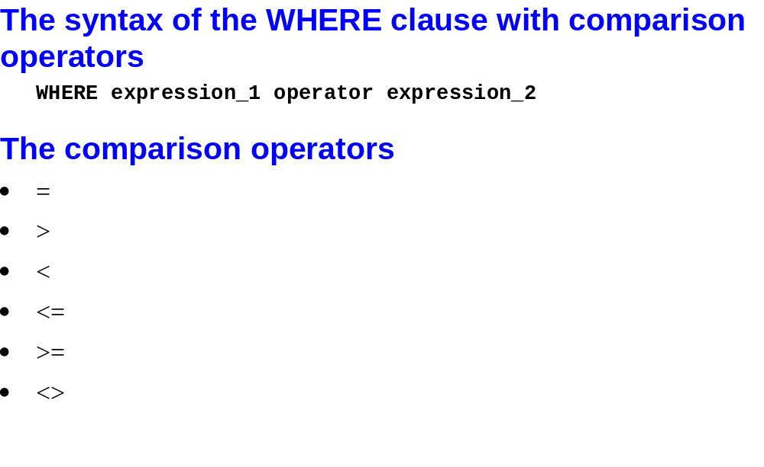
Murach’s Oracle SQL and PL/SQL, C3
© 2014, Mike Murach & Associates, Inc.
Slide <number>

Slide 32
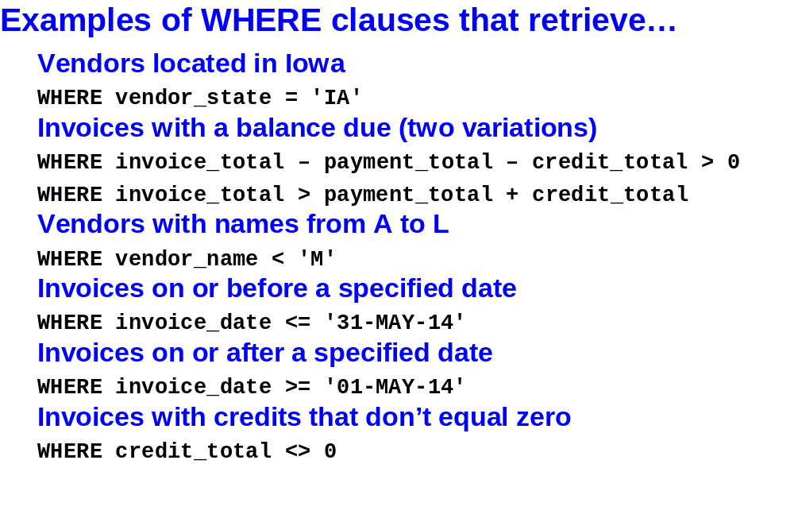
Murach’s Oracle SQL and PL/SQL, C3
© 2014, Mike Murach & Associates, Inc.
Slide <number>

Slide 33
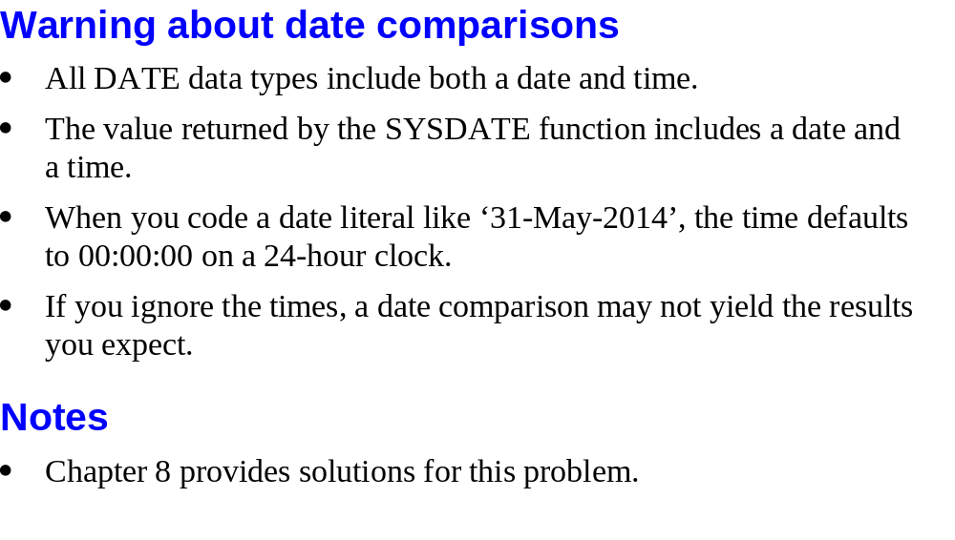
Murach’s Oracle SQL and PL/SQL, C3
© 2014, Mike Murach & Associates, Inc.
Slide <number>

Slide 34
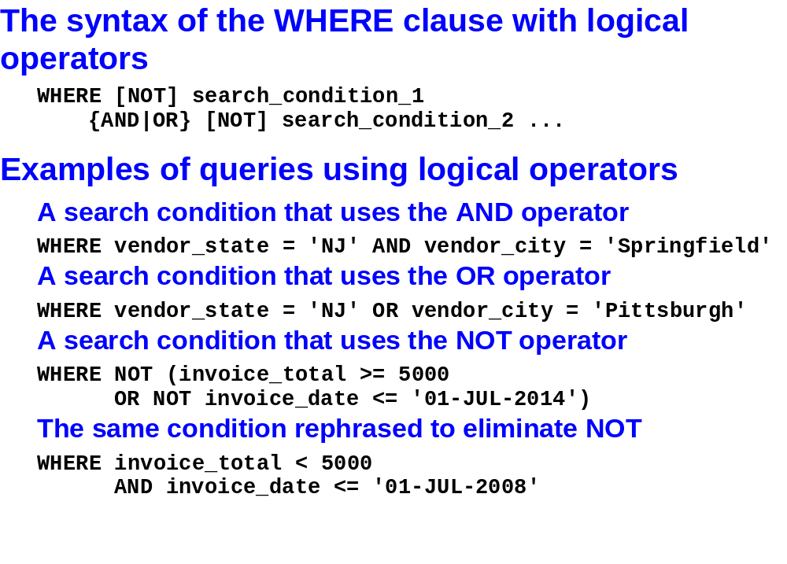
Murach’s Oracle SQL and PL/SQL, C3
© 2014, Mike Murach & Associates, Inc.
Slide <number>

Slide 35



Murach’s Oracle SQL and PL/SQL, C3
© 2014, Mike Murach & Associates, Inc.
Slide <number>

Slide 36


Murach’s Oracle SQL and PL/SQL, C3
© 2014, Mike Murach & Associates, Inc.
Slide <number>

Slide 37

Murach’s Oracle SQL and PL/SQL, C3
© 2014, Mike Murach & Associates, Inc.
Slide <number>

Slide 38

Murach’s Oracle SQL and PL/SQL, C3
© 2014, Mike Murach & Associates, Inc.
Slide <number>

Slide 39

Murach’s Oracle SQL and PL/SQL, C3
© 2014, Mike Murach & Associates, Inc.
Slide <number>

Slide 40

Murach’s Oracle SQL and PL/SQL, C3
© 2014, Mike Murach & Associates, Inc.
Slide <number>

Slide 41


Murach’s Oracle SQL and PL/SQL, C3
© 2014, Mike Murach & Associates, Inc.
Slide <number>

Slide 42


Murach’s Oracle SQL and PL/SQL, C3
© 2014, Mike Murach & Associates, Inc.
Slide <number>

Slide 43



Murach’s Oracle SQL and PL/SQL, C3
© 2014, Mike Murach & Associates, Inc.
Slide <number>

Slide 44


Murach’s Oracle SQL and PL/SQL, C3
© 2014, Mike Murach & Associates, Inc.
Slide <number>

Slide 45

Murach’s Oracle SQL and PL/SQL, C3
© 2014, Mike Murach & Associates, Inc.
Slide <number>

Slide 46


Murach’s Oracle SQL and PL/SQL, C3
© 2014, Mike Murach & Associates, Inc.
Slide <number>

Slide 47


Murach’s Oracle SQL and PL/SQL, C3
© 2014, Mike Murach & Associates, Inc.
Slide <number>

Slide 48


Murach’s Oracle SQL and PL/SQL, C3
© 2014, Mike Murach & Associates, Inc.
Slide <number>

Slide 49


Murach’s Oracle SQL and PL/SQL, C3
© 2014, Mike Murach & Associates, Inc.
Slide <number>

Slide 50

Murach’s Oracle SQL and PL/SQL, C3
© 2014, Mike Murach & Associates, Inc.
Slide <number>

Slide 51

Murach’s Oracle SQL and PL/SQL, C3
© 2014, Mike Murach & Associates, Inc.
Slide <number>

Slide 52


Murach’s Oracle SQL and PL/SQL, C3
© 2014, Mike Murach & Associates, Inc.
Slide <number>

Slide 53


Murach’s Oracle SQL and PL/SQL, C3
© 2014, Mike Murach & Associates, Inc.
Slide <number>

Slide 54


Murach’s Oracle SQL and PL/SQL, C3
© 2014, Mike Murach & Associates, Inc.
Slide <number>

